Slide 1
Numerical Algorithms
ITCS 4/5145 Parallel Computing UNC-Charlotte, B. Wilkinson, 2009.

Slide 2
Numerical Algorithms
• Matrix multiplication
• Solving a system of linear equations

Slide 3
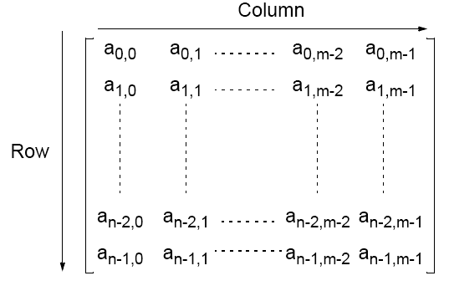
Matrices — A Review
An n x m matrix

Slide 4
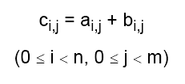
Matrix Addition
Involves adding corresponding elements of each matrix to form the result matrix.
Given the elements of A as ai,j and the elements of B as bi,j, each element of C is computed as

Slide 5

Matrix Multiplication
Multiplication of two matrices, A and B, produces matrix C
whose elements, ci,j (0 <= i < n, 0 <= j < m), are computed as follows:
where A is an n x l matrix and B is an l x m matrix.

Slide 6
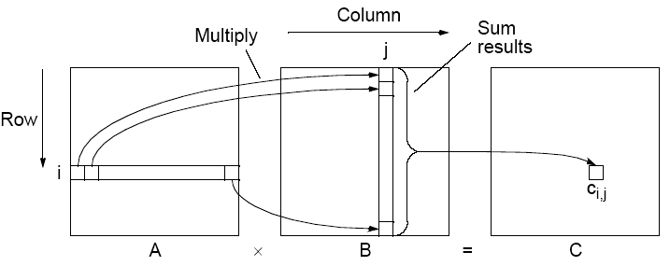
Matrix multiplication, C = A x B

Slide 7
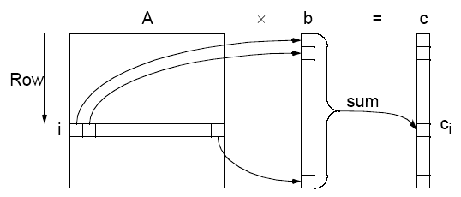
Matrix-Vector Multiplication
c = A x b
Matrix-vector multiplication follows directly from the definition of matrix-matrix multiplication by making B an n x1 matrix (vector). Result an n x 1 matrix (vector).

Slide 8
Relationship of Matrices to Linear Equations
A system of linear equations can be written in matrix form:
Ax = b
Matrix A holds the a constants
x is a vector of the unknowns
b is a vector of the b constants.

Slide 9
Implementing Matrix Multiplication
Sequential Code
Assume throughout that matrices square (n x n matrices).
Sequential code to compute A x B could simply be
for (i = 0; i < n; i++)
for (j = 0; j < n; j++) {
c[i][j] = 0;
for (k = 0; k < n; k++)
c[i][j] = c[i][j] + a[i][k] * b[k][j];
}
Requires n³ multiplications and n³ additions
Sequential time complexity of O(n³).
Very easy to parallelize.

Slide 10
Parallel Code
With n processors (and n x n matrices), can obtain:
• Time complexity of O(n²) with n processors
Each instance of inner loop independent and can be done
by a separate processor
• Time complexity of O(n) with n² processors
One element of A and B assigned to each processor.
Cost optimal since O(n³) = n x O(n²) = n² x O(n)].
• Time complexity of O(log n) with n³ processors
By parallelizing the inner loop. Not cost-optimal.
O(log n) lower bound for parallel matrix multiplication.

Slide 11
Partitioning into Submatrices
Suppose matrix divided into s² submatrices.
Each submatrix has n/s x n/s elements.
A_{p,q} means submatrix row p and column q of matrix A:
for (p = 0; p < s; p++)
for (q = 0; q < s; q++) {
C_{p,q} = 0; /* clear elements of submatrix */
for (r = 0; r < m; r++) /* submatrix multiplication &*/
C_{p,q} = C_{p,q} + A_{p,r} * B_{r,q}; /*add to accum. submatrix*/
}
The line: C_{p,q} = C_{p,q} + A_{p,r} * B_{r,q};
means multiply submatrix A_{p,r} and B_{r,q} using matrix multiplication
and add to submatrix C_{p,q} using matrix addition. Known as block
matrix multiplication.

Slide 12
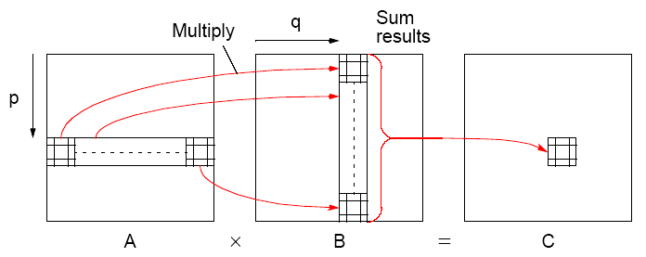
Block Matrix Multiplication

Slide 13
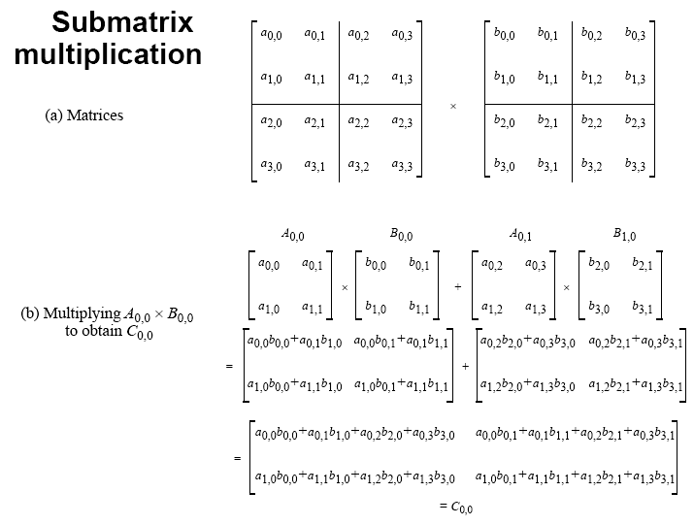

Slide 14
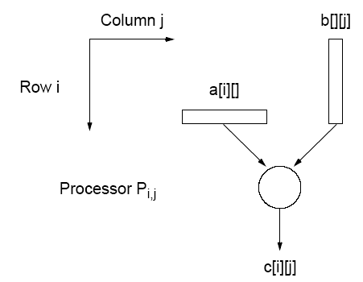
Direct Implementation
One processor to compute each element of C
n² processors needed.
Each processor needs one row of elements of A and one column of elements of B.
Can use submatrices.

Slide 15
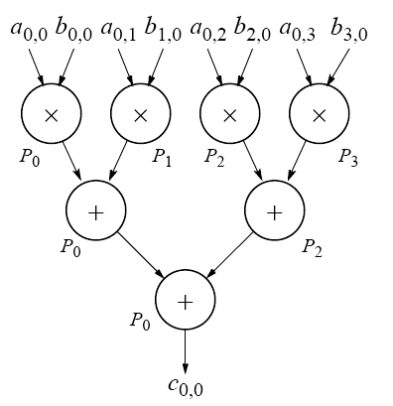
Performance Improvement
Tree construction: n numbers can be added in log n steps
using n processors:
Computational time
complexity of O(log n)
using n³ processors.

Slide 16
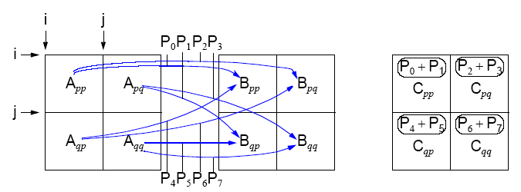
Recursive Implementation
Apply same algorithm on each submatrix recursively.
Excellent algorithm for a shared memory systems because of
locality of operations.

Slide 17
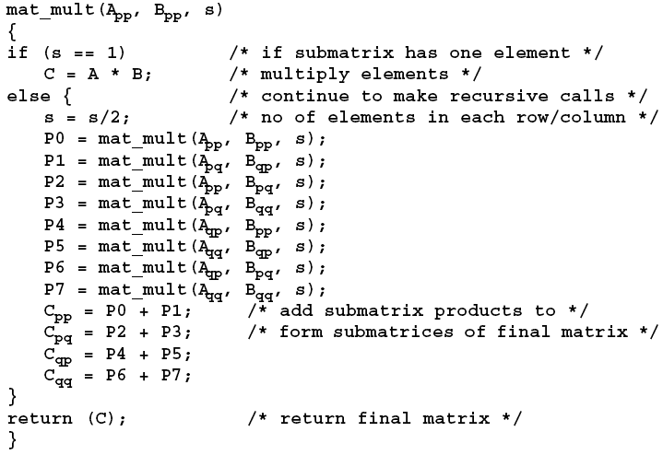
Recursive Algorithm

Slide 18
Mesh Implementations
• Cannon’s algorithm
• Fox’s algorithm (not in textbook but similar complexity)
• Systolic array
All involve using processor arranged a mesh and shifting elements of the arrays through the mesh. Accumulate the partial sums at each processor.

Slide 19
Mesh Implementations
Cannon’s Algorithm
Mesh of processors with wraparound connections to shift the A
elements (or submatrices) left and the B elements (or submatrices) up.
Initially processor P_{i,j} has elements a_{i,j} and b_{i,j} (0 <= i < n, 0 <= k < n).
2. Elements moved from their initial position to an “aligned” position. ith row of A is shifted i places left and jth column of B is shifted j places upward. Has effect of placing element a_{i,j+}i and element b_{i+j,j} in processor P_{i,j}. These elements are a pair of those required in accumulation of c_{i,j}.
3. Each processor, P_{i,j}, multiplies its elements.
4. The ith row of A is shifted one place right, and the jth column of B is shifted one place upward. Has the effect of bringing together adjacent elements of A and B, which will also be required in the accumulation.
5. Each processor, P_{i,j}, multiplies elements brought to it and adds result to accumulating sum.
6. Step 4 and 5 repeated until final result obtained (n - 1 shifts with
n rows and n columns of elements).

Slide 20
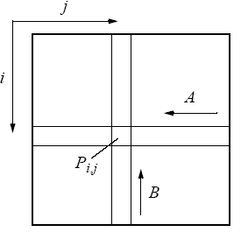
Movement of A and B elements

Slide 21
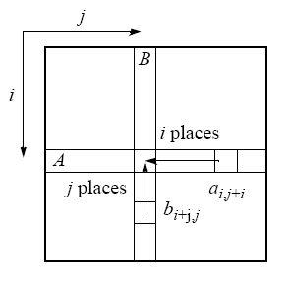
Step 2 — Alignment of elements of A and B

Slide 22
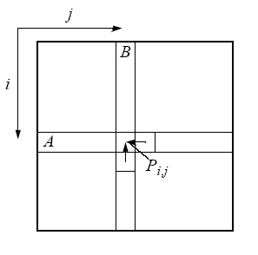
Step 4 - One-place shift of elements of A and B

Slide 23
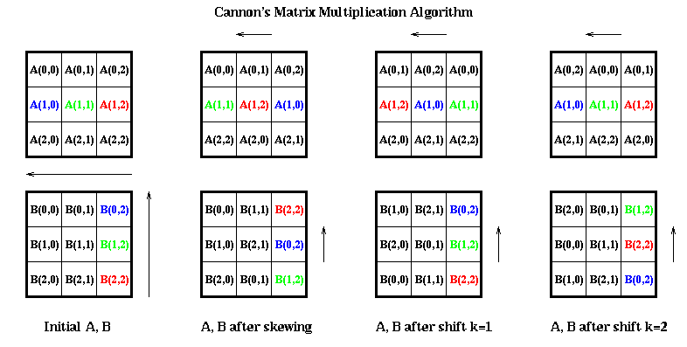
הפרוססורים נייחים והמספרים מוזזים
C11 = a12.b21 + a10.b01+a11.b11
http://www.eecs.berkeley.edu/~demmel/cs267/lecture11/lecture11.html
Notes:
משמאל לימין. עמודה הכי שמאלית = מצב ראשוני. עמודה 2 משמאל: הבאה למצב התחלתי. 0 הזזה בשביל שורה ראשונה ב A ועמודה ראשונה של B, 1 הזזה לשורה 2 של A ועמודה 2 של B וכך הלאה. בעמודות שלוש וארבע יש בכל שלב הזזה אחד של כל השורות/עמודות. התוצאה הסופית היא סכום המכפלות שמוקפות בעיגולים

Slide 24
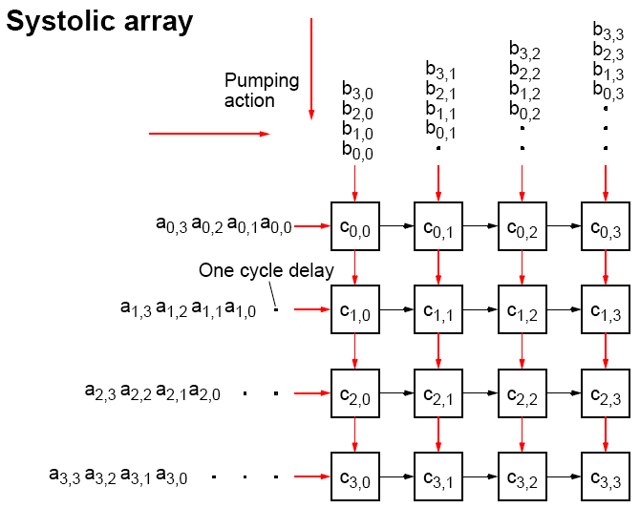

Slide 25
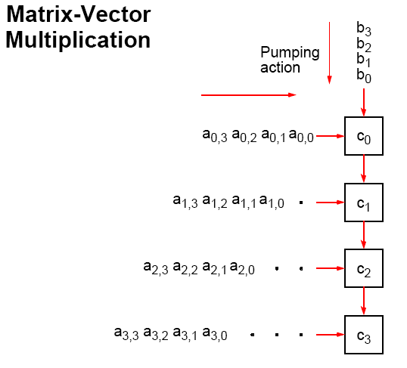

Slide 26
הגענו עד לפה

Slide 27
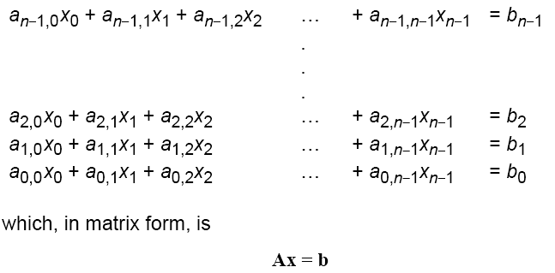
Solving a System of Linear Equations
Objective is to find values for the unknowns, x₀, x₁, …, xn-1, given values for a_{0,0}, a_{0,1}, …, a_{n-1,n-1}, and b₀, …, b_{n} .

Slide 28
Solving System of Linear Equations
Dense matrices
Gaussian Elimination - parallel time complexity O(n²)
Sparse matrices
By iteration - depends upon iteration method and number of
iterations but typically O(log n)
• Jacobi iteration
• Gauss-Seidel relaxation (not good for parallelization)
• Red-Black ordering
• Multigrid

Slide 29

Gaussian Elimination
Convert general system of linear equations into triangular system of equations. Then solve by Back Substitution.
Uses characteristic of linear equations that any row can be replaced by that row added to another row multiplied by a constant.
Starts at first row and works toward bottom row. At ith row, each row j below ith row replaced by row j + (row i) (-aj,i/ ai,i).
Constant used for row j is -aj,i/ai,i. Has effect of making all elements in ith column below ith row zero because:

Slide 30
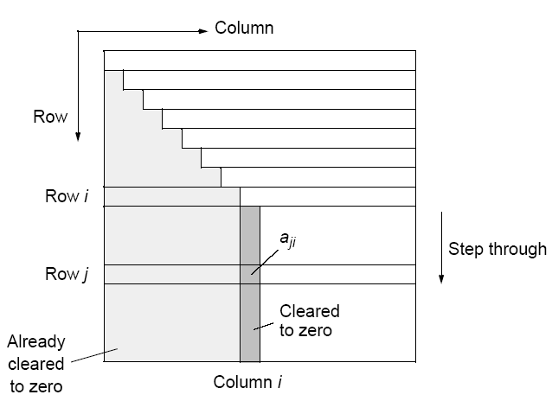
Gaussian elimination

Slide 31
Partial Pivoting
If ai,i is zero or close to zero, will not be able to compute
quantity -aj,i/ai,i.
Procedure must be modified into so-called partial pivoting by swapping ith row with row below it that has largest absolute element in ith column of any of rows below ith row if there is one. (Reordering equations will not affect the system.)
In the following, we will not consider partial pivoting.

Slide 32
Sequential Code
Without partial pivoting:
for (i = 0; i < n-1; i++) /* for each row, except last */
for (j = i+1; j < n; j++) { /*step thro subsequent rows */
m = a[j][i]/a[i][i]; /* Compute multiplier */
for (k = i; k < n; k++) /*last n-i-1 elements of row j*/
a[j][k] = a[j][k] - a[i][k] * m;
b[j] = b[j] - b[i] * m; /* modify right side */
}
The time complexity is O(n³).

Slide 33
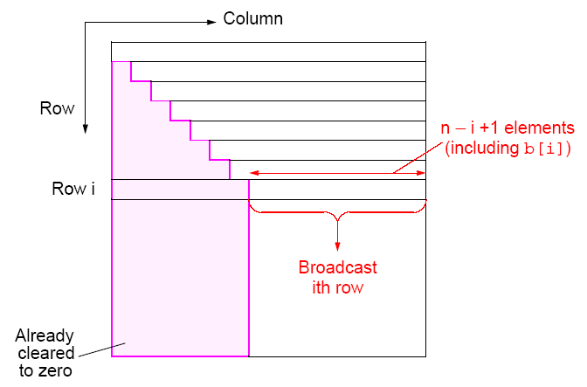
Parallel Implementation

Slide 34
Analysis
Communication
n - 1 broadcasts performed sequentially.
ith broadcast contains n - i + 1 elements.
Time complexity of O(n²) (see textbook)
Computation
After row broadcast, each processor Pj beyond broadcast processor Pi will compute its multiplier, and operate upon n - j + 2 elements of its row. Ignoring computation of multiplier, n - j + 2 multiplications and n - j + 2 subtractions.
Time complexity of O(n²) (see textbook).
Efficiency relatively low because all processors before processor holding row i do not participate in computation again.

Slide 35
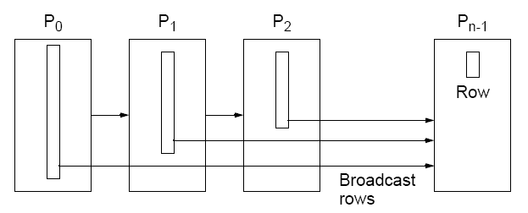
Pipeline implementation of Gaussian elimination

Slide 36
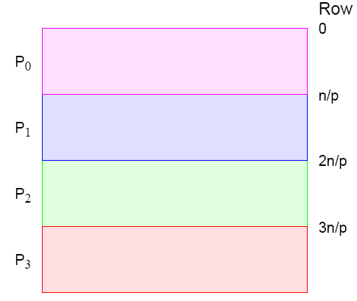
Strip Partitioning
Poor processor allocation! Processors do not participate in
computation after their last row is processed.

Slide 37
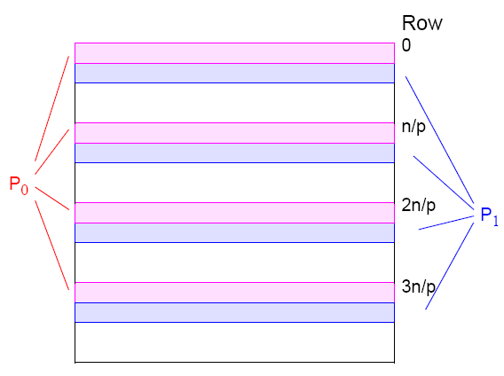
Cyclic-Striped Partitioning
An alternative which equalizes the processor workload:

Slide 38
Iterative Methods
Time complexity of direct method at O(n²) with n processors, is
significant.
Time complexity of iteration method depends upon:
• type of iteration,
• number of iterations
• number of unknowns, and
• required accuracy
but can be less than direct method especially for a few
unknowns i.e. a sparse system of linear equations.

Slide 39
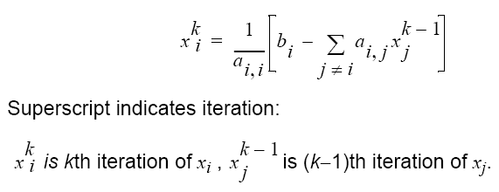
Jacobi Iteration
Iteration formula: ith equation rearranged to have ith unknown on left side:

Slide 40
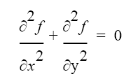
Example of a Sparse System of Linear Equations
Laplace’s Equation
Solve for f over the two-dimensional x-y space.
For computer solution, finite difference methods appropriate
Two-dimensional solution space “discretized” into large number of solution points.

Slide 41
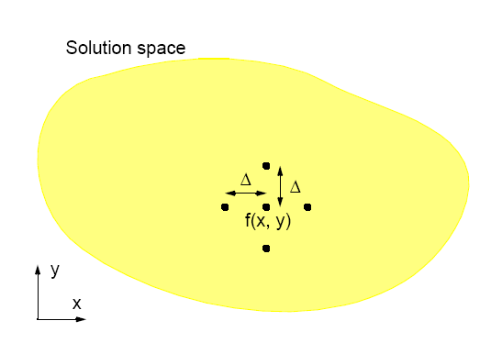
Finite Difference Method

Slide 42
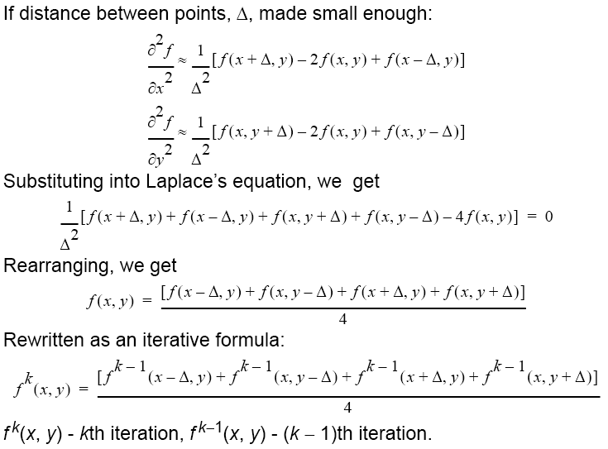

Slide 43
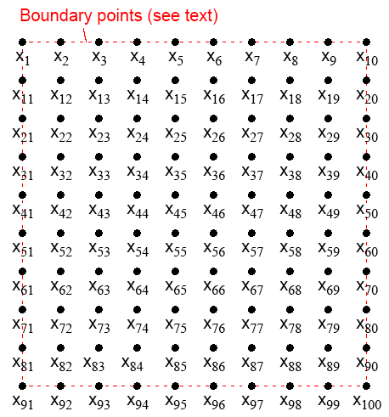
Natural Order

Slide 44
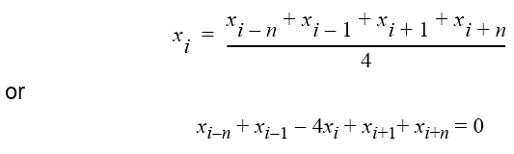

Relationship with a General System of Linear Equations
Using natural ordering, ith point computed from ith equation:
which is a linear equation with five unknowns (except those with boundary points).
In general form, the ith equation becomes:

Slide 45
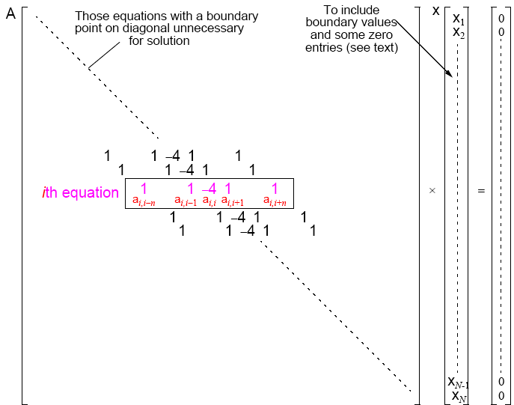

Slide 46
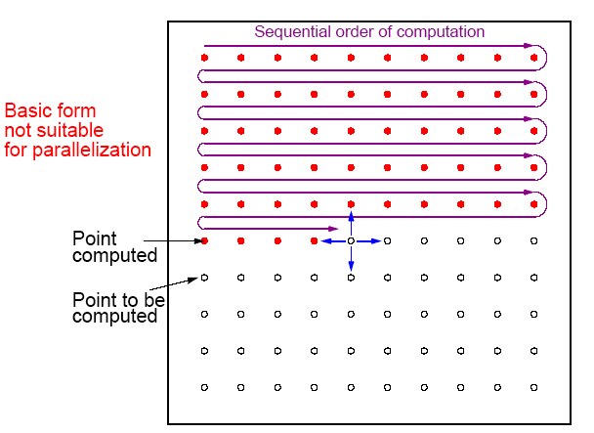
Gauss-Seidel Relaxation
Uses some newly computed values to compute other values in that iteration.

Slide 47


Gauss-Seidel Iteration Formula
where superscript indicates iteration.
With natural ordering of unknowns, formula reduces to
At kth iteration, two of the four values (before ith element)
taken from kth iteration and two values (after ith element)
taken from (k-1)th iteration. Have:

Slide 48
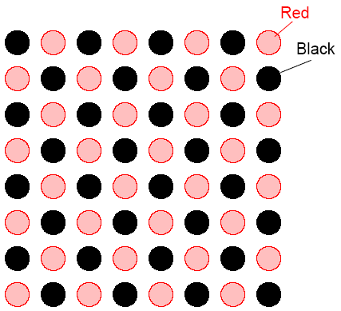
Red-Black Ordering
First, black points computed. Next, red points computed. Black
points computed simultaneously, and red points computed
simultaneously.

Slide 49
Red-Black Parallel Code
forall (i = 1; i < n; i++)
forall (j = 1; j < n; j++)
if ((i + j) % 2 == 0) /* compute red points */
f[i][j] = 0.25*(f[i-1][j] + f[i][j-1] + f[i+1][j] + f[i][j+1]);
forall (i = 1; i < n; i++)
forall (j = 1; j < n; j++)
if ((i + j) % 2 != 0) /* compute black points */
f[i][j] = 0.25*(f[i-1][j] + f[i][j-1] + f[i+1][j] + f[i][j+1]);

Slide 50
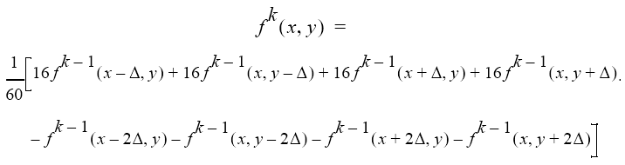
Higher-Order Difference Methods
More distant points could be used in the computation. The following update formula:

Slide 51
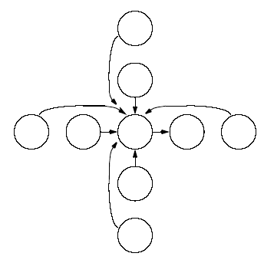
Nine-point stencil

Slide 52
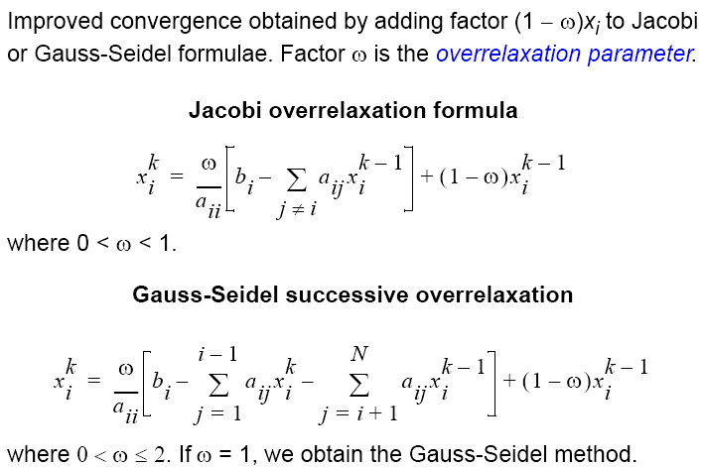
Overrelaxation

Slide 53
Multigrid Method
First, a coarse grid of points used. With these points, iteration process will start to converge quickly.
At some stage, number of points increased to include points of coarse grid and extra points between points of coarse grid. Initial values of extra points found by interpolation. Computation continues with this finer grid.
Grid can be made finer and finer as computation proceeds, or computation can alternate between fine and coarse grids.
Coarser grids take into account distant effects more quickly and provide a good starting point for the next finer grid.

Slide 54
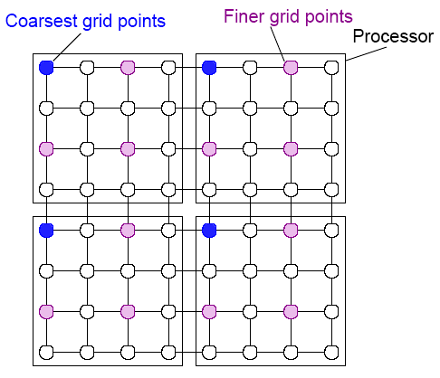
Multigrid processor allocation

Slide 55
(Semi) Asynchronous Iteration
As noted early, synchronizing on every iteration will cause significant overhead - best if one can is to synchronize after a
number of iterations.

